Slide 1
Constructor

Slide 2
Constructor
A class constructor is a special member function of a class that is executed whenever we create new objects of that class.
A constructor will have exact same name as the class and it does not have any return type at all, not even void. Constructors can be very useful for setting initial values for certain member variables.
The Compiler calls the Constructor whenever an object is created.
Constructors can be defined either inside the class definition or outside class definition using class name and scope resolution :: operator.

Slide 3
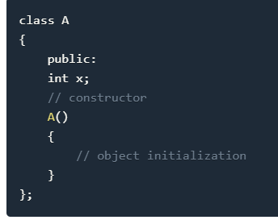
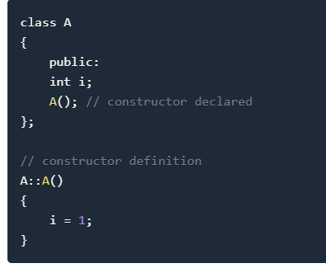
Types of Constructors in C++
Default Constructor
Parametrized Constructor
Copy Constructor

Slide 4
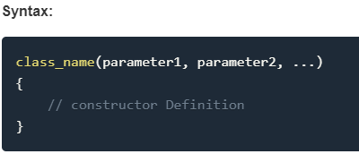
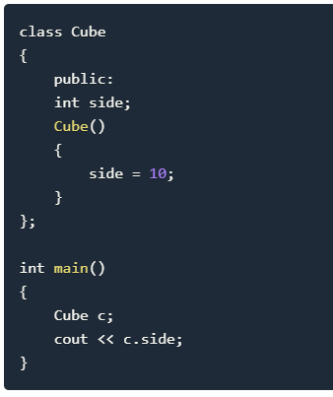
Default Constructor
Default constructor is the constructor which doesn't take any argument. It has no parameter.

Slide 5
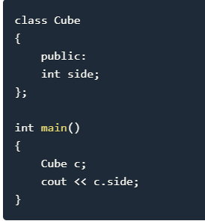
In this case, as soon as the object is created the constructor is called which initializes its data members.
A default constructor is so important for initialization of object members, that even if we do not define a constructor explicitly, the compiler will provide a default constructor implicitly.
In this case, default constructor provided by the compiler will be called which will initialize the object data members to default value, that will be 0 or any random integer value in this case.

Slide 6
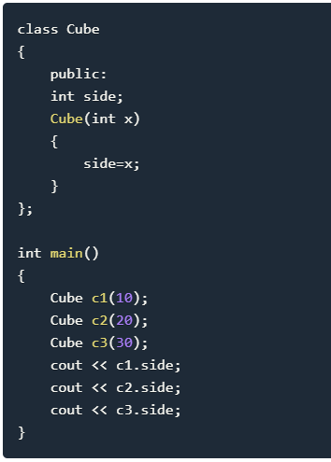
Parametrized Constructor
These are the constructors with parameter. Using this Constructor you can provide different values to data members of different objects, by passing the appropriate values as argument.

Slide 7
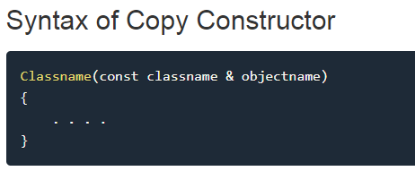
Copy Constructor
Copy Constructor is a type of constructor which is used to create a copy of an already existing object of a class type.
It is usually of the form X (X&), where X is the class name.
The compiler provides a default Copy Constructor to all the classes.
As it is used to create an object, hence it is called a constructor. And, it creates a new object, which is exact copy of the existing copy, hence it is called copy constructor.

Slide 8
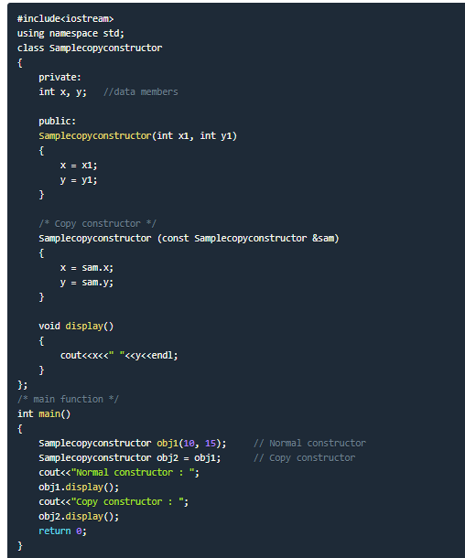

Slide 9
The Class Destructor
A destructor is a special member function of a class that is executed whenever an object of it's class goes out of scope or whenever the delete expression is applied to a pointer to the object of that class.
A destructor will have exact same name as the class prefixed with a tilde (~) and it can neither return a value nor can it take any parameters. Destructor can be very useful for releasing resources before coming out of the program like closing files, releasing memories etc.

Slide 10
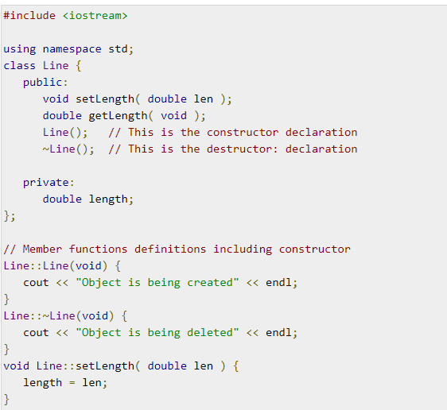
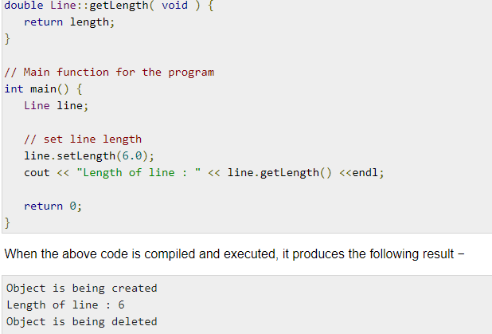

Slide 11
Constructor Overloading in C++
Just like other member functions, constructors can also be overloaded. Infact when you have both default and parameterized constructors defined in your class you are having Overloaded Constructors, one with no parameter and other with parameter.
You can have any number of Constructors in a class that differ in parameter list.
In above case we have defined two constructors with different parameters, hence overloading the constructors.
One more important thing, if you define any constructor explicitly, then the compiler will not provide default constructor and you will have to define it yourself.
In the above case if we write Student S; in main(), it will lead to a compile time error, because we haven't defined default constructor, and compiler will not provide its default constructor because we have defined other parameterized constructors.

Slide 12
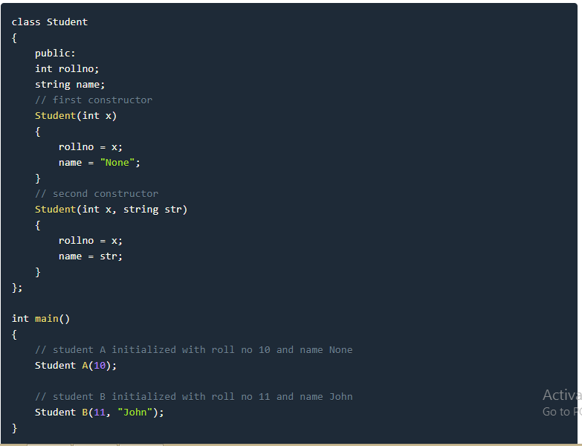

Slide 13
Static Keyword
Static is a keyword in C++ used to give special characteristics to an element.
Static elements are allocated storage only once in a program lifetime in static storage area. And they have a scope till the program lifetime. Static Keyword can be used with following,
Static variable in functions
Static Class Objects
Static member Variable in class
Static Methods in class

Slide 14
Static Data Member in Class
Static data members of class are those members which are shared by all the objects. Static data member has a single piece of storage, and is not available as separate copy with each object, like other non-static data members.
Static member variables (data members) are not initialied using constructor, because these are not dependent on object initialization.
Also, it must be initialized explicitly, always outside the class. If not initialized, Linker will give error.

Slide 15
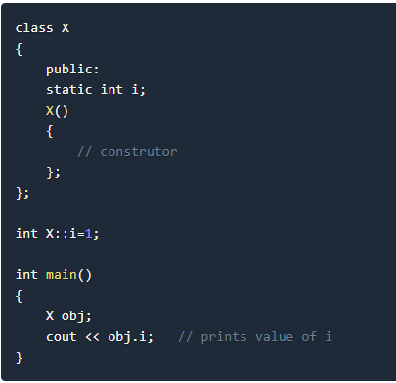

Slide 16
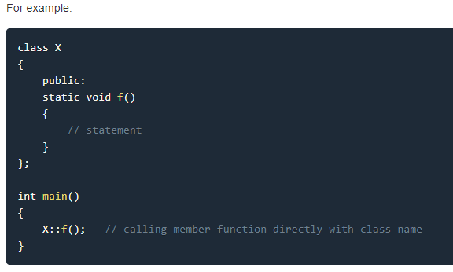
Static Member Functions
These functions work for the class as whole rather than for a particular object of a class.
It can be called using an object and the direct member access . operator. But, its more typical to call a static member function by itself, using class name and scope resolution :: operator.

Slide 17
These functions cannot access ordinary data members and member functions, but only static data members and static member functions.
It doesn't have any "this" keyword which is the reason it cannot access ordinary members.

Slide 18
Function Overloading
Function overloading is a C++ programming feature that allows us to have more than one function having same name but different parameter list, when I say parameter list, it means the data type and sequence of the parameters,
for example the parameters list of a function myfuncn(int a, float b) is (int, float) which is different from the function myfuncn(float a, int b) parameter list (float, int). Function overloading is a compile-time polymorphism.
E.g sum(int num1, int num2)
sum(int num1, int num2, int num3)
sum(int num1, double num2)

